Slide 1
Titanic data set: Feature analysis and survivability prediction
Konrad Siebor

Slide 2
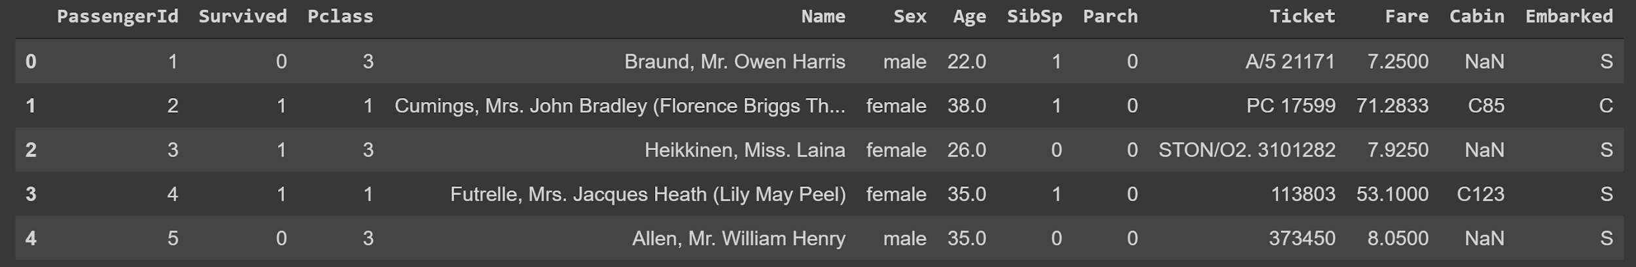
Titanic Data Set Overview
Available on Kaggle
891 unique Titanic passengers
12 features or variables
Contains which passengers did and did not survive the sinking of the Titanic
0 = Died, 1 = Survived
# of Siblings/Spouses
# of Parents/Children
Port of Entry*
*C = Cherbourg, Q = Queenstown, S = Southampton

Slide 3
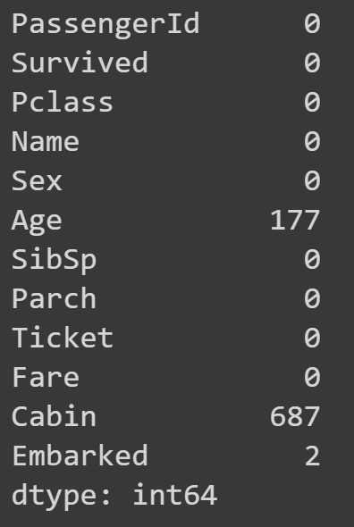
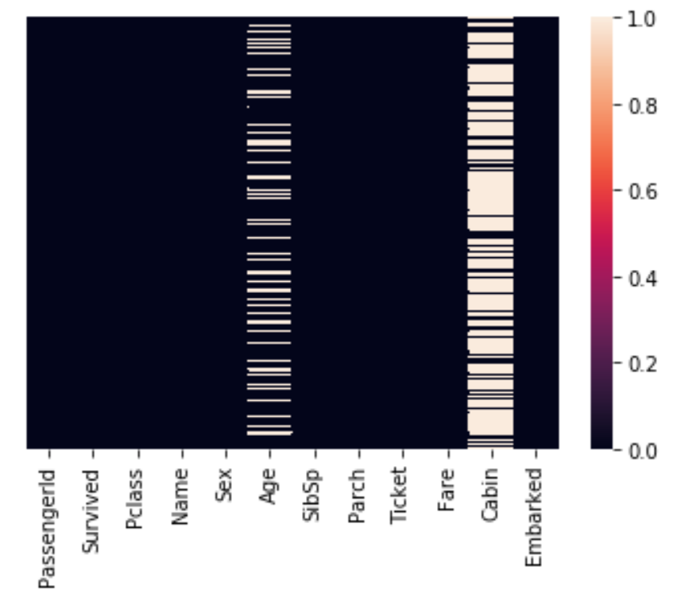
Data Clean-Up
Missing data in Age and Cabin Fields
Missing data visualization

Slide 4
Data Clean-Up
Insufficient information to extrapolate missing null values
Remove the Age and Cabin features from the data set

Slide 5
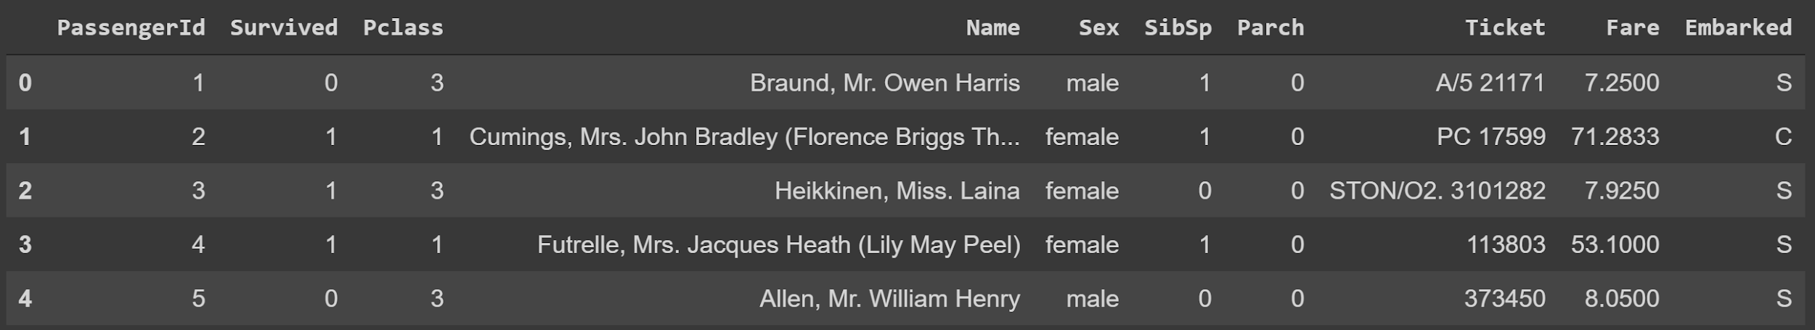
Unnecessary Features
PassengerId contains redundant passenger indexing
Ticket contains semi-random alphanumeric code
Name is unique to each passenger → Little Predictive Value

Slide 6
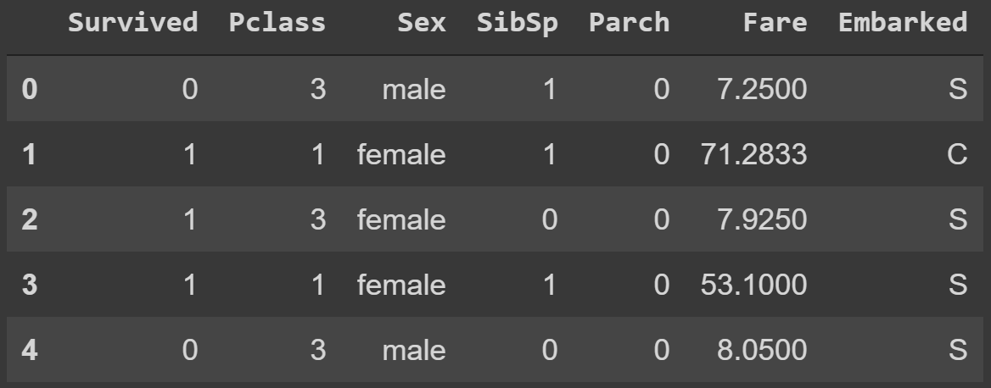
Final Data Set
6 distinct features
“Survived” serves as the data label

Slide 7
Primary Research Questions:
How are the features correlated with survivability?
Can these features be used to predict survivability?

Slide 8
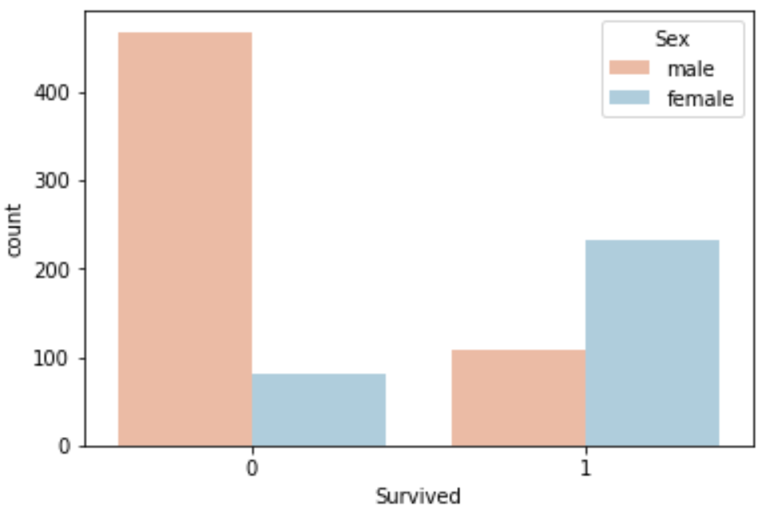
Exploratory Visualizations
A far higher number of men did not survive than women

Slide 9
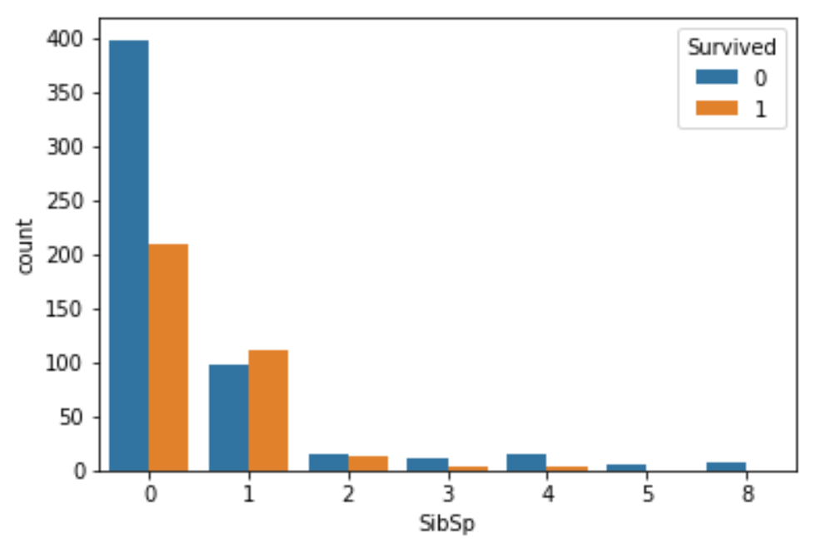
Exploratory Visualizations
Majority of passengers had 0 or 1 siblings/spouses onboard: only ~8% had >= 2
Higher proportion of passengers with 0 siblings did not survive

Slide 10
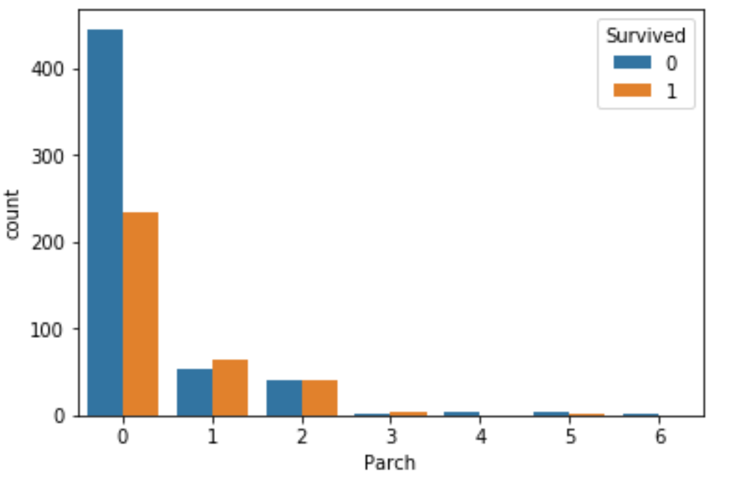
Exploratory Visualizations
A majority of passengers had 0, 1, or 2 parents/children: only ~2% had >=3
Higher proportion of passengers with 0 parents and children did not survive

Slide 11
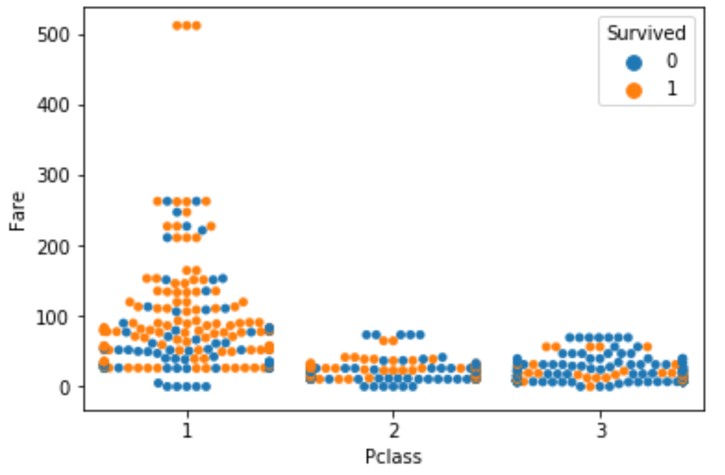
Exploratory Visualizations
Passengers in 1st class tended to pay a higher fare
Passengers in 1st class had a higher probability of surviving than those in 2nd and 3rd

Slide 12
Predictive Modeling
Input Features
Model?
Predictions
Evaluate Performance
Fine-tune and Improve

Slide 13
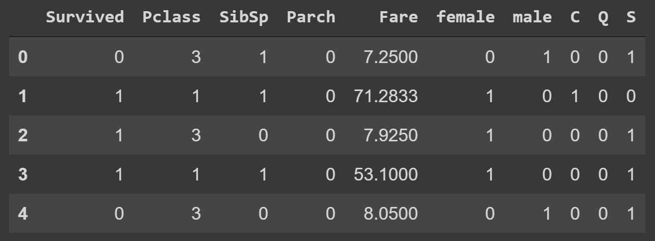
Transform Categorical Data
Sex and Embarked Fields contain categorical data that is unreadable to Machine Learning algorithms
Transform to quantitative data using dummy variables

Slide 14
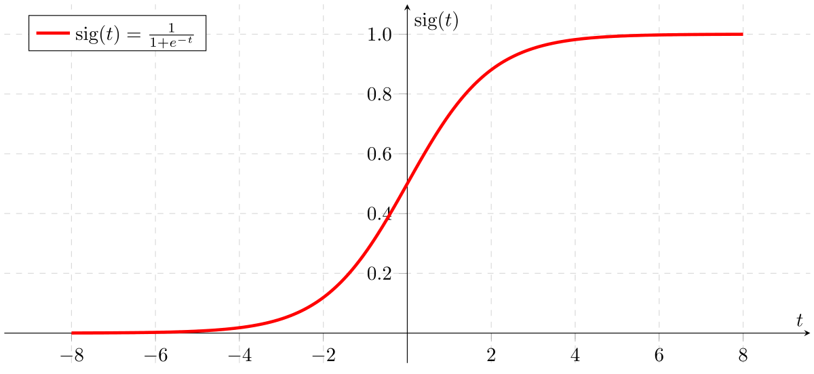
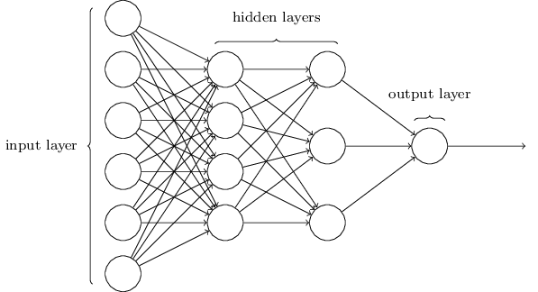
Machine Learning Algorithms
Python scikit-learn package
Optimize on training data → Evaluate on test data
Output probability of survival 0-1
Algorithms:
Logistic Regression
Multilayer Perceptron

Slide 15
Splitting Data Set
70% Training Data
891 Passengers Data
30% Test Data

Slide 16
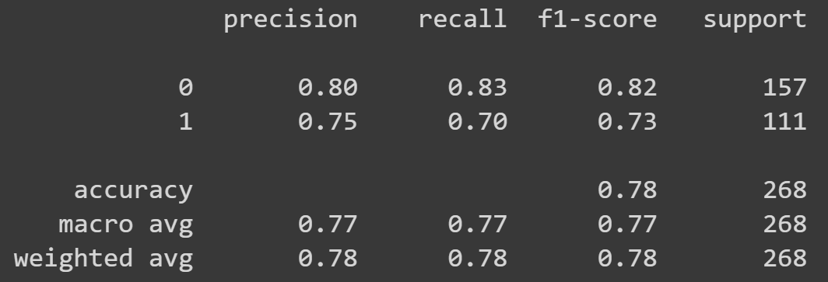
Logistic Regression Performance
Achieved 78% Accuracy

Slide 17
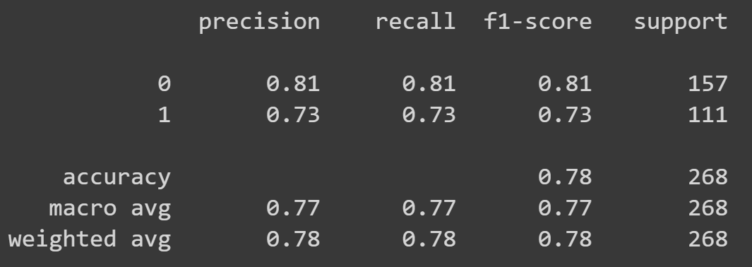
Multilayer Perceptron
Achieved 78% Accuracy

Slide 18
Conclusions and Future Outlook
Cleaned, formated, and visually analyzed data features
Successfully created an accurate Titanic survivability predictive model using two different ML algorithms
Improvements: Employ deep learning models using advanced libraries such as Keras and TensorFlow

